Slide 1
Lending Club Case Study
Vishwas Tiwari

Slide 2
Objective
The goal of this case study is to apply Exploratory Data Analysis (EDA) techniques to a practical problem and communicate the insights in a business-centric manner through a presentation.
Advantages of the case study:-
Provides insights into the practical application of EDA in real-world business scenarios. Facilitates the development of fundamental knowledge in risk analytics within the banking and financial services sectors. Illustrates how data analysis is utilized to mitigate financial losses associated with lending to clients. Enhances comprehension of visualization techniques and the selection of appropriate charts for analyzing real-world data.

Slide 3
Business Understanding
The primary business objective is to make informed decisions on loan applications by evaluating specific variables, leading to either approval or rejection.
Dataset Details:
The dataset provided comprises information about previous loan applicants and their default status. Specifically, it includes details on approved loans, categorizing them into three statuses: Fully Paid, Current, and Charged-Off. Notably, the dataset does not encompass information on rejected loan applications.

Slide 4
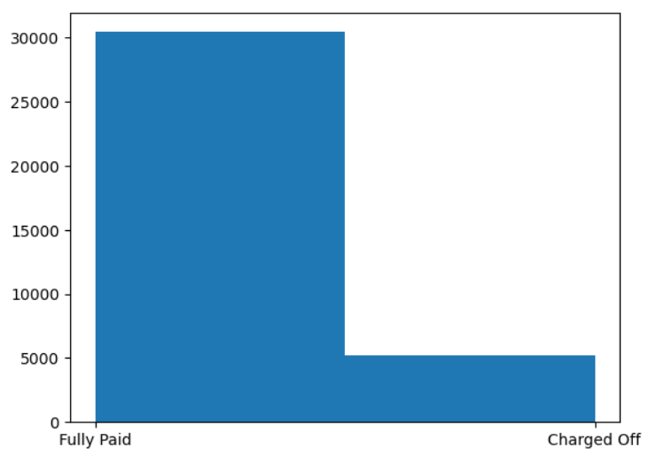
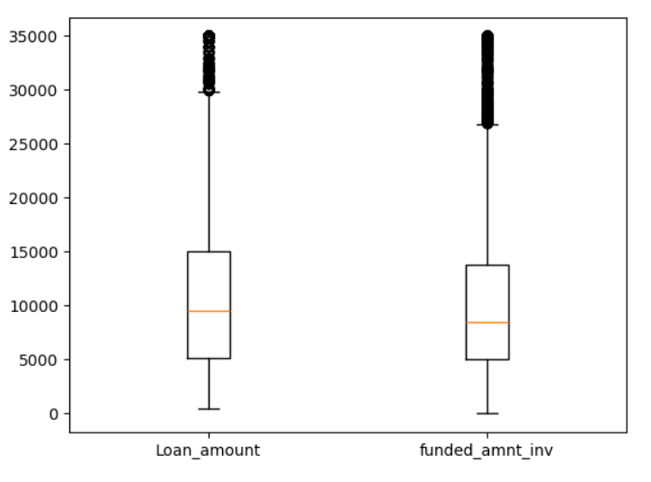
Loan Status and Amount
Loan Status: The number of charged-off loans is significantly smaller (14.5%) compared to the total count of loans.
Loan Amount: The loan amounts vary from $500 to $35,000, with a median of $10,000. Most loans are small, and only a few clients have taken larger loans. As the loan amount increases, the chance of defaulting also rises.

Slide 5
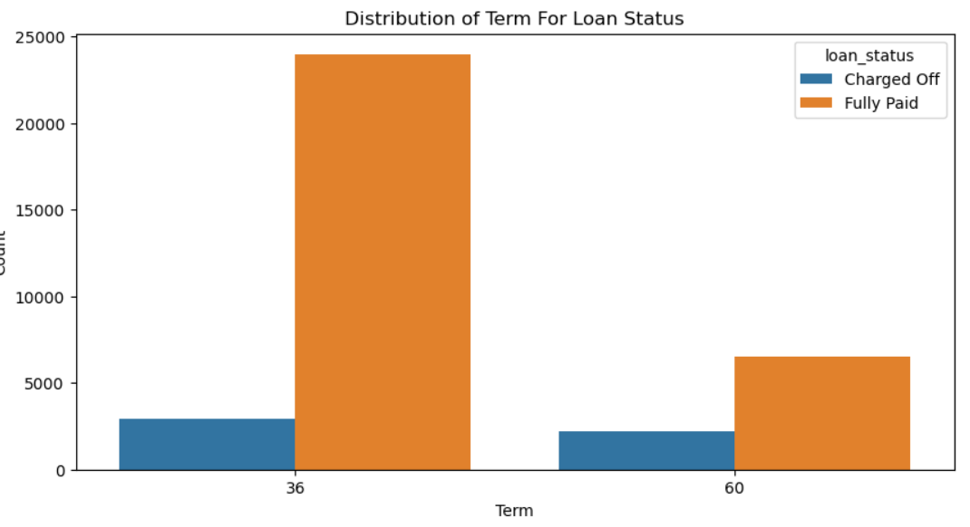
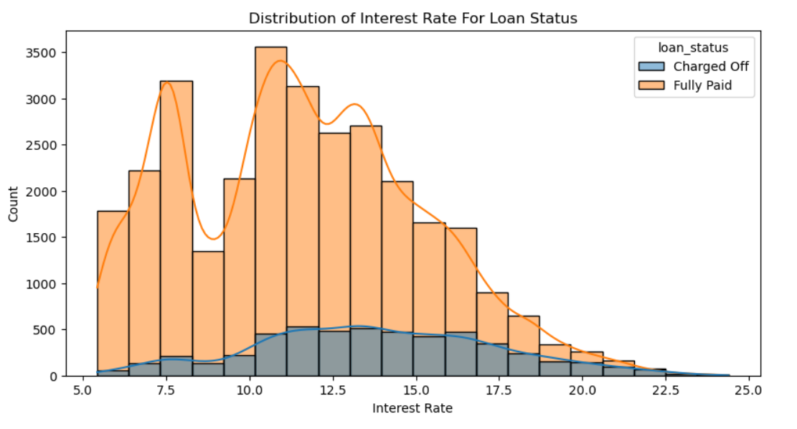
Term and Interest Rate
Loan Term: Loans with a 36-month term are significantly more prevalent than those with a 60-month term and exhibit a lower chance of defaulting.
Interest Rate: The count of loans taken varies with the interest rate, peaking around the 5-15 bracket and decreasing gradually. However, the likelihood of defaulting increases with the interest rate.

Slide 6
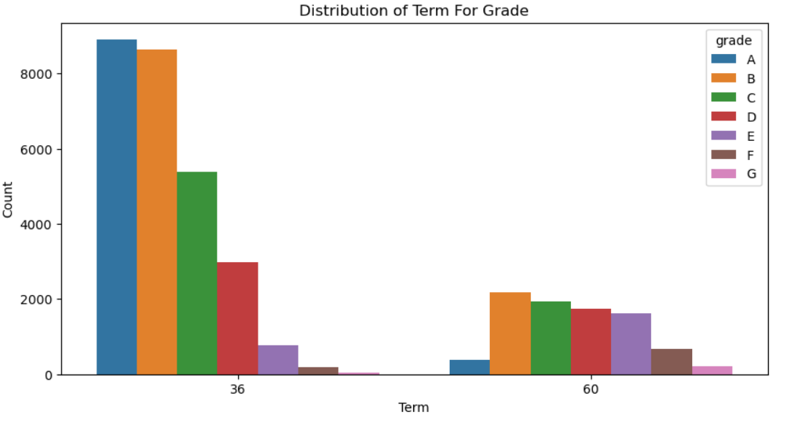
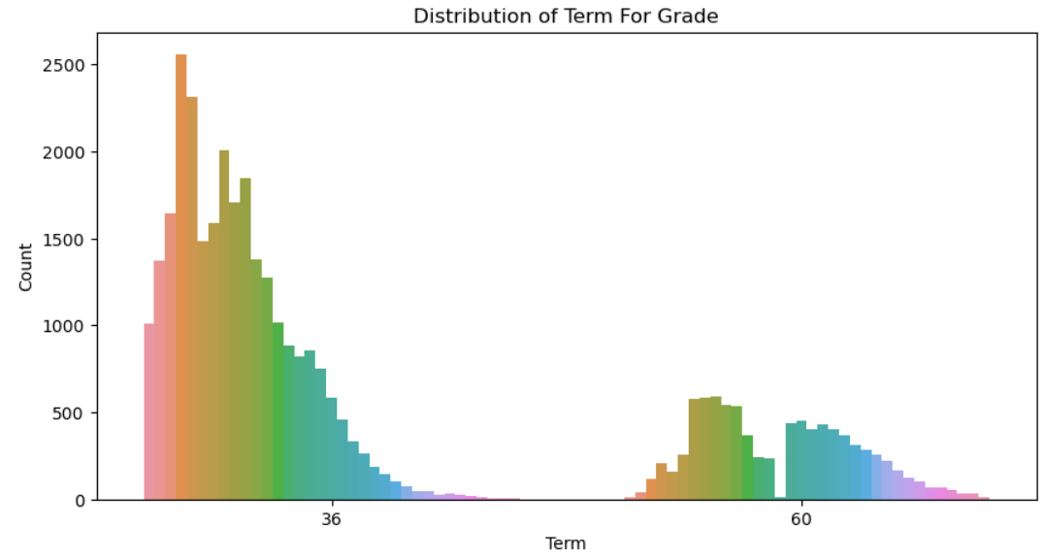

Grade and Sub-Grade
Grade: The approved loans primarily consist of higher-grade loans, reflecting lower risk and a reduced chance of defaulting. However, 60-month term loans exhibit a larger number of lower-grade loans, indicating higher risk associated with this term length.
Sub Grade: This insight reveals that loans within a specific grade tend to be skewed towards lower sub-grades, suggesting a broader spectrum of risk within each grade category.

Slide 7
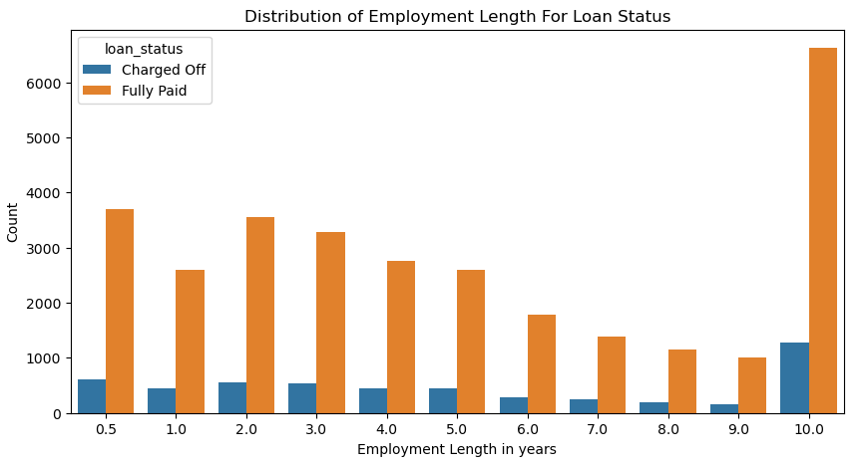
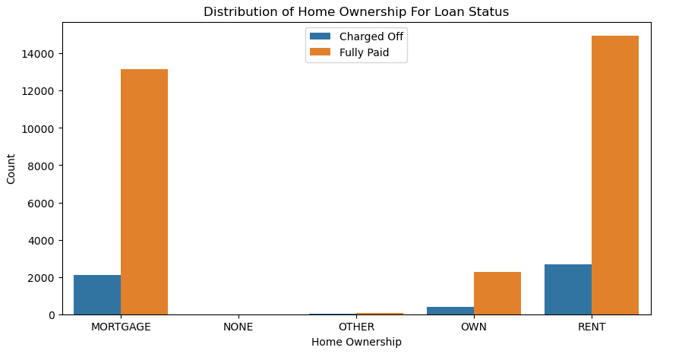
Employment Length & Homeownership
Employment Length: The majority of clients possess 10+ years of experience, yet they also account for the highest number of defaulted loans.
Home Ownership: The majority of clients do not own any property and are either renting or have a mortgage, increasing their likelihood of defaulting.

Slide 8
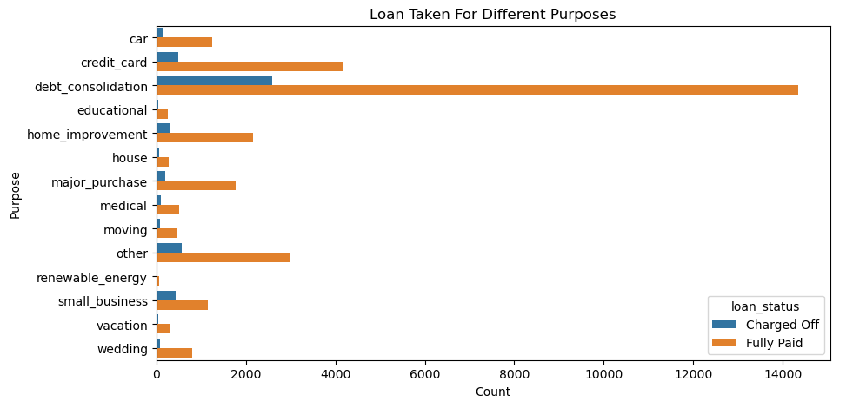
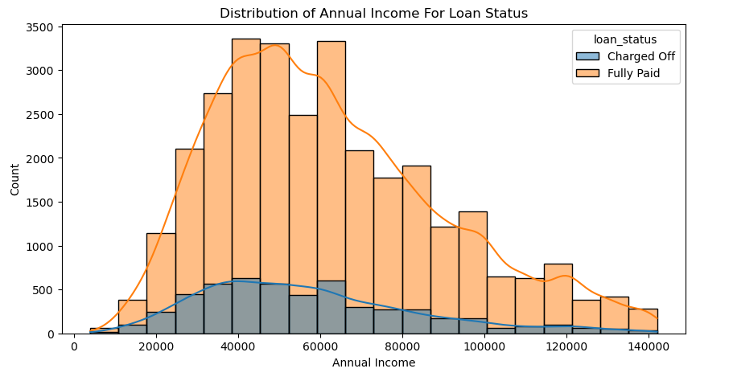
Annual Income & Purpose
Annual Income : Most clients exhibit lower annual incomes compared to others, and those with incomes below $50,000 have a higher likelihood of defaulting.
Purpose: The primary reasons for loan acquisition are debt consolidation followed by credit card payments. While debt consolidation accounts for the highest number of fully paid loans, it also records the highest number of defaulted loans.

Slide 9
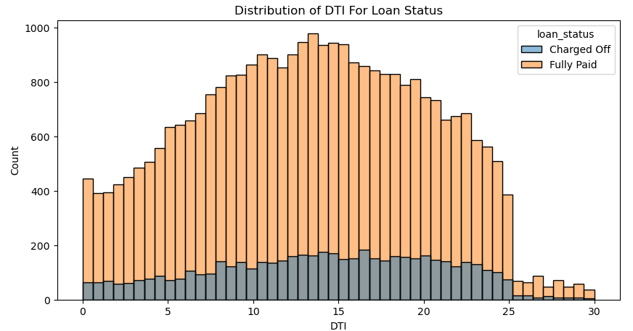
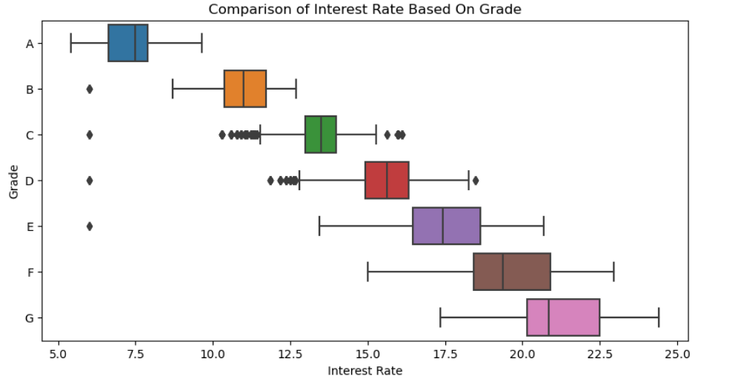
DTI ratio and Interesest rate on grade
DTI: A substantial portion of clients exhibit high Debt-to-Income (DTI) ratios, signaling potential risk associated with lending to these individuals.
Interest rate on grade : The assigned grade indicates the level of risk, consequently implying that interest rates rise in correlation with the level of risk.

Slide 10
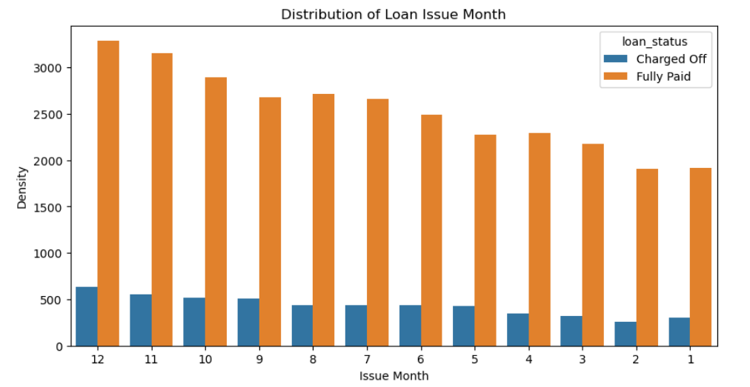
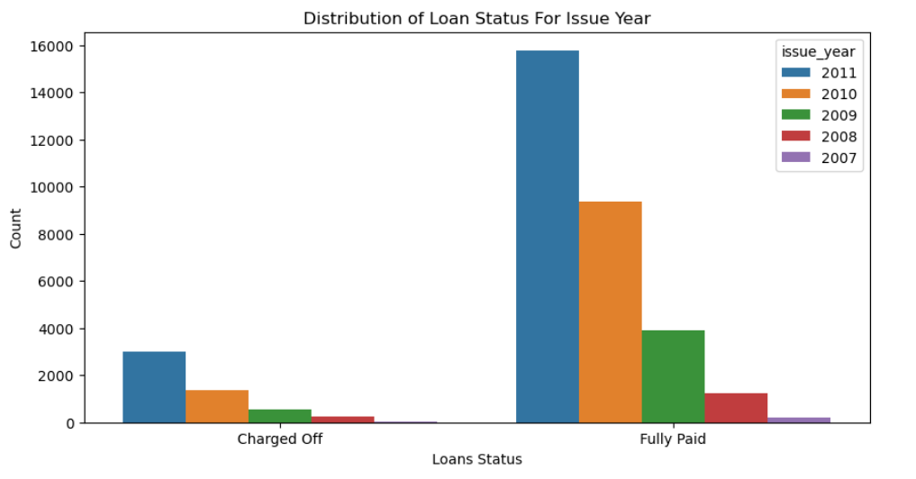
Loan Trend over years
Loan uptake increases gradually throughout the year, with lower default rates in April, August, and December quarters, suggesting improved repayment behavior later in the year.
Yearly loan uptake demonstrates exponential growth, suggesting a considerable increase in Debt-to-Income (DTI) ratios and a simultaneous decrease in default rates over time.

Slide 11
Observations
Major Driving factor which can be used to predict the chance of defaulting and avoiding Credit Loss:
DTI
Grades
Annual income
Pub_rec_bankruptcies
Other Observations-
lower grades such as E, F, or G, indicating elevated risk levels are not good choice for loan.
Borrowers with notably high Debt-to-Income (DTI) ratios are likely to be defaulters.
Borrowers possessing 10 or more years of work experience are likely to be defaulters.
The default loan amount increases with interest rate and shows are decline aftre 17.5 % interest rate.
Borrowers with an annual income ranging from $50,000 to $100,000 are likely to default.
The Defaulted loan are lower for the burrowers which own their property compared to on mortgage or rent.
The brrowers are mostly having no record of Public Recorded Bankruptcy and are safe choice for loan issue.

